Slide 1

ATM Machine in c language
BY:
Tamer Ahmed 21-101103 DR: Basma Hussin
Marwan Sultan 21-101138 DR: karim swelim
Ahmed Tarek 21-101141
Yousef Tamer 21-101113

Slide 2

Outline
What is our project?
Why did we select the ATMS project?
Output to cardless services
Output to card services
Libararies
references

Slide 3

Why did we select the ATM?
one of the most important services is the automated teller machines whose service has been developed and link all banks through a unified, secure, and advanced network.
Because ATMs machine save to people the time to make any transaction.
ATMs were fully integrated into modern society .
In 1977, when a massive snowstorm shut down the city ATM usage increased by 20% as all of the banks were closed.
AS 2019, there were more than 3 million ATMs across the globe and as more people use credit and debit cards for many transactions.
In past, you can use ATMs to buy airline tickets and medicine.
This Photo by Unknown author is licensed under CC BY-NC.

Slide 4
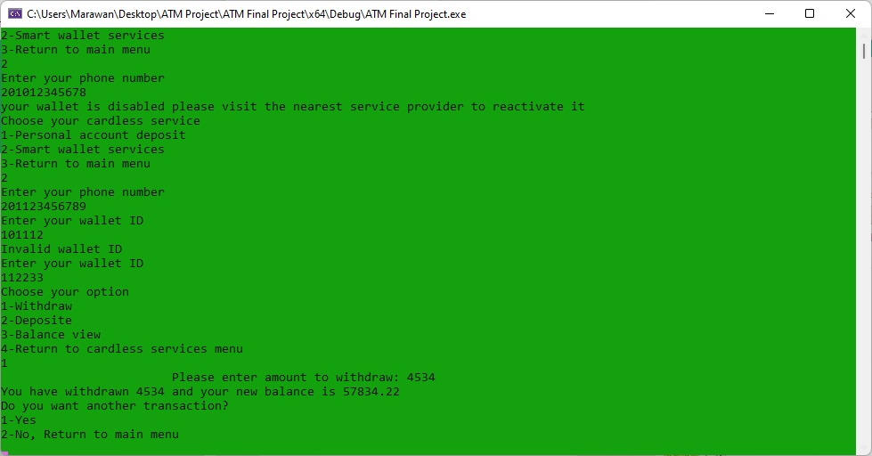
Output to card-less service

Slide 5
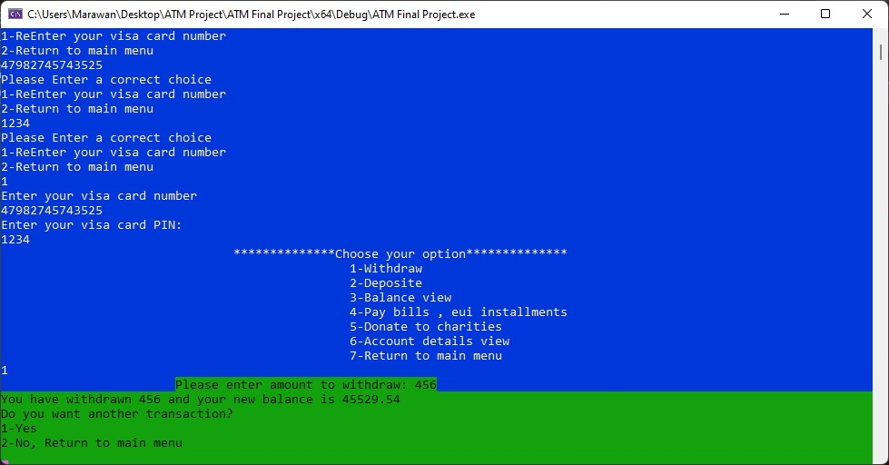
Output to card services

Slide 6
Libraries
#include<windows.h> //this library to display background
#include <time.h> //this library to display time of transaction
#include <MMsystem.h> //this library to display sound
#include<cstdlib>//this library to display sound
#pragma warning(disable : 4996) //to avoid warning

Slide 7

References
www.microsoft.com (1)
This Photo by Unknown author is licensed under CC BY-NC-ND.

